Slide 1
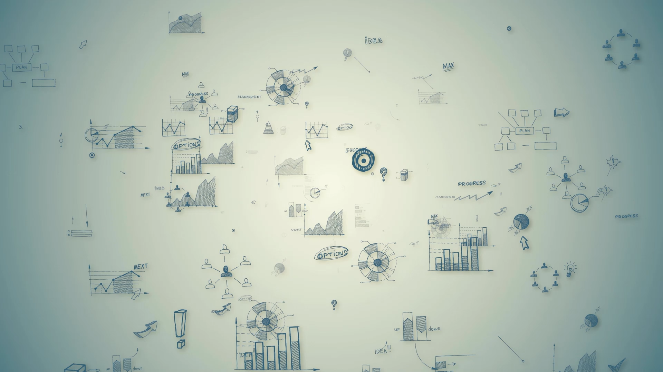
Human Movement Analytics using AI
~ Supervisor: Dr Luo Wei
GeoSpatialX lab
~ Aditya Katkuri

Slide 2
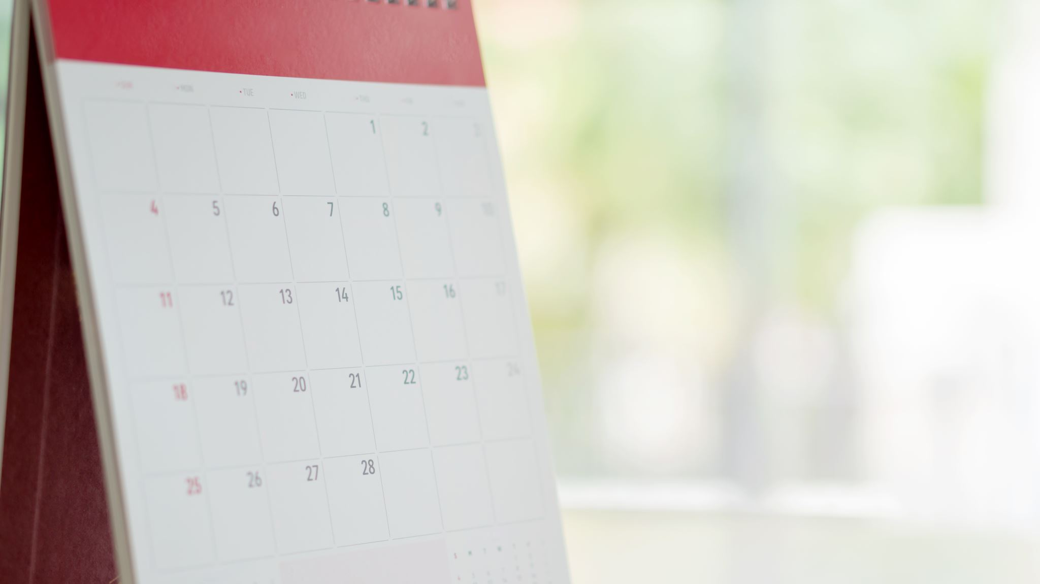
Update-1: 5th May

Slide 3
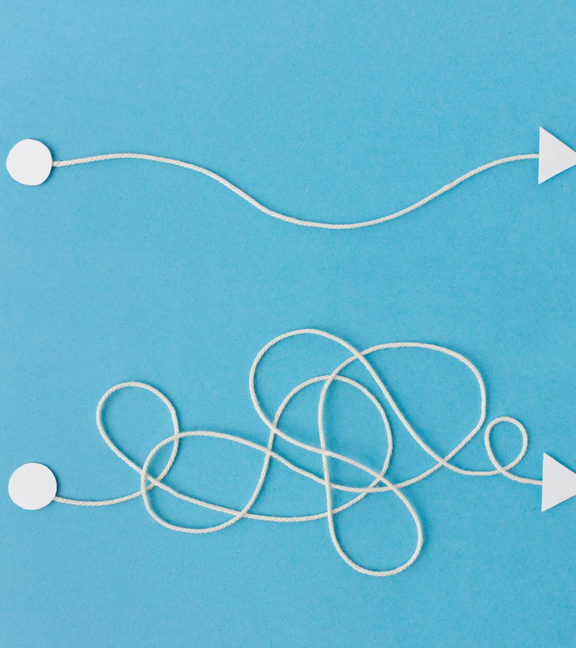
Goals
Chord diagram
Network Flow Analysis
Exploring other potential AI methodologies for Human Movement Analysis

Slide 4
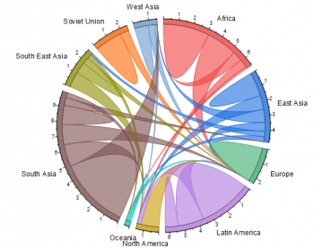
Chord Diagram
Example:
Doesn’t include the temporal depth of the data.
Almost done implementing it using our data
Preprocessing etc is done but there’s an error while plotting.
Link to code on Google Collab:
https://colab.research.google.com/drive/135wgj8K1l623K8VetCACIB7vCKaQEI2x?usp=sharing

Slide 5
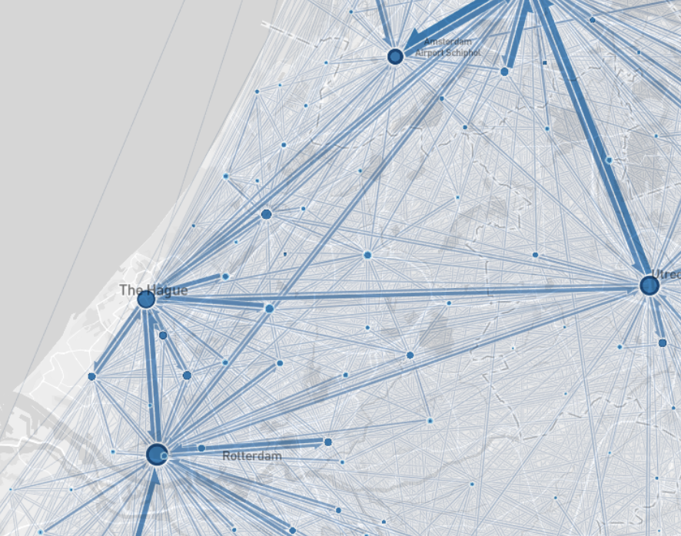
Network Flow Analysis
Example:
Doesn’t include the temporal depth of the data.
Implementation in the preprocessing stage.
Will be done using GeoPandas.
Work on this is handled by Me and Thashmitha
Individually.
Work on Chord diagram will be done and then
I will complete implementing this.

Slide 6
Exploring other potential AI methodologies for Human Movement Analysis
Explored nature and PNAS
Found 2 relevant papers on nature and 4 in PNAS
Best bet would be Graph ML
Ashish and Shubham are working on implementing Graph ML

Slide 7
Next Steps
Complete implementing Chord diagram and Network Flow Diagram by next meeting.
Find other potential AI integration approaches.

Slide 8
Update-2: 30th June

Slide 9
Chord Diagram
Chord Diagram made for
Almost done implementing it using our data
Preprocessing etc is done but there’s an error while plotting.
Link to code on Google Collab:
https://colab.research.google.com/drive/135wgj8K1l623K8VetCACIB7vCKaQEI2x?usp=sharing

Slide 10
Network Flow Analysis
Example:
Doesn’t include the temporal depth of the data.
Implementation in the preprocessing stage.
Will be done using GeoPandas.
Work on this is handled by Me and Thashmitha
Individually.
Work on Chord diagram will be done and then
I will complete implementing this.

Slide 11
Next Step
Use human movement data to analyze flow during various COVID stages and relate it to policy.
Network analysis over space and time.
Papers on cell phone data analysis, during calamities.
Other directions possible.

